Slide 1
CLUSTWEET
Use the power of social media to target your users
Tommaso Agnolazza
Alessandro Ciresola
Davide Lucchi

Slide 2




Social Media Users
328 Million
2 Billion
700 Million
1 Billion

Slide 3



Learn about users through data
What?
Habits
Interests
Likes
Dislikes
Why?
Users’ groups
Sell Targeted Advertisements
Discover new trends

Slide 4

Learn about users through data
How can we achieve that?
Clustering
Users with the same interests can be gathered into the same cluster

Slide 5




Twitter and K-center Clustering
Dataset:
200 000 Tweets
Tweets between 14-16/04/2016
Main Algorithm:
K-Center clustering
Framework:
Apache Spark
Java 1.8
Stanford Natural Language Processing

Slide 6
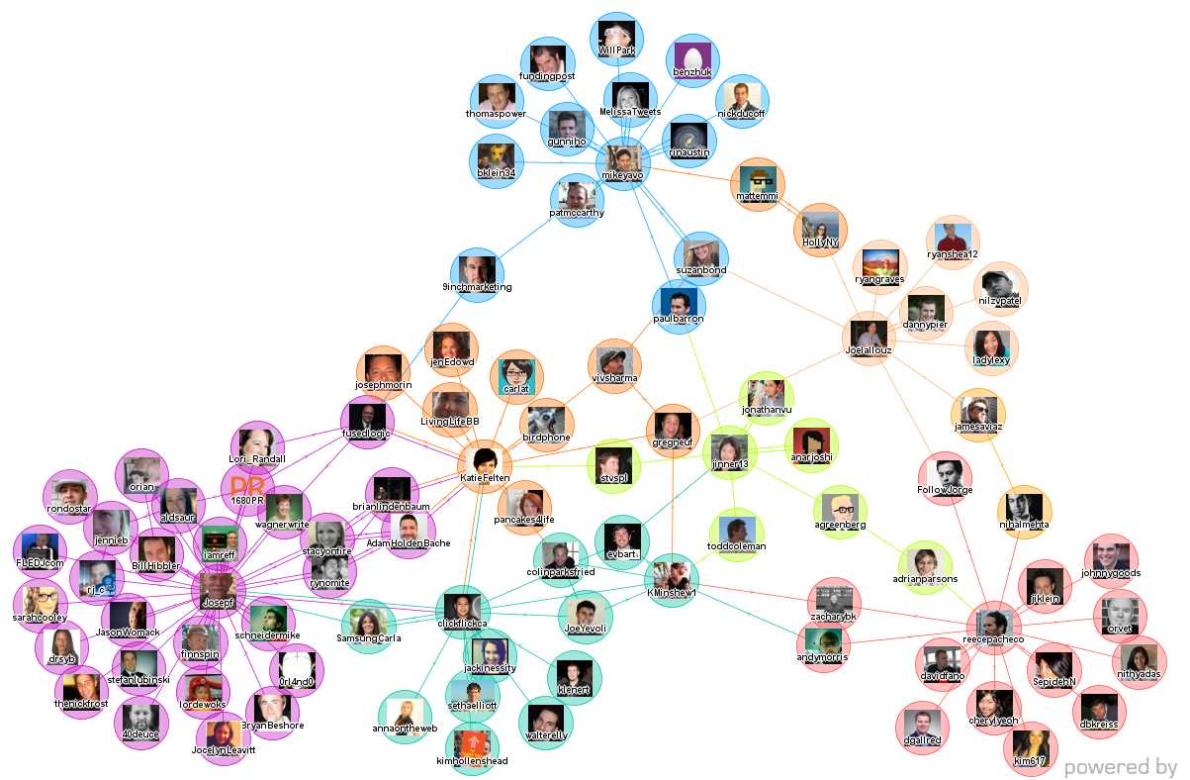

Twitter and K-center Clustering
C1
Example of k-center clustering over a Twitter conversation network
C5
C4
C2
C3

Slide 7
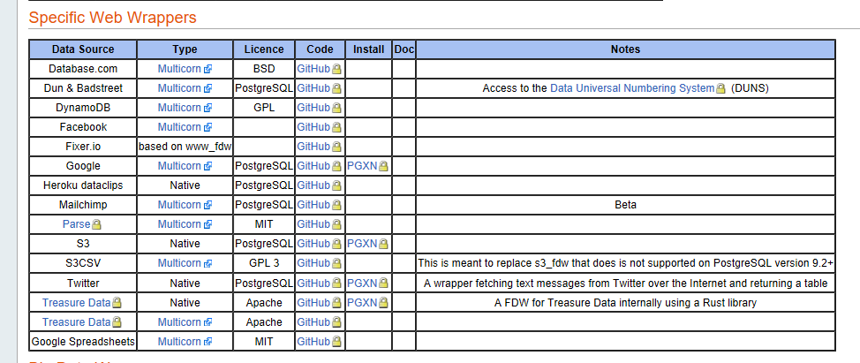
Issues with the Twitter fdw

Slide 8
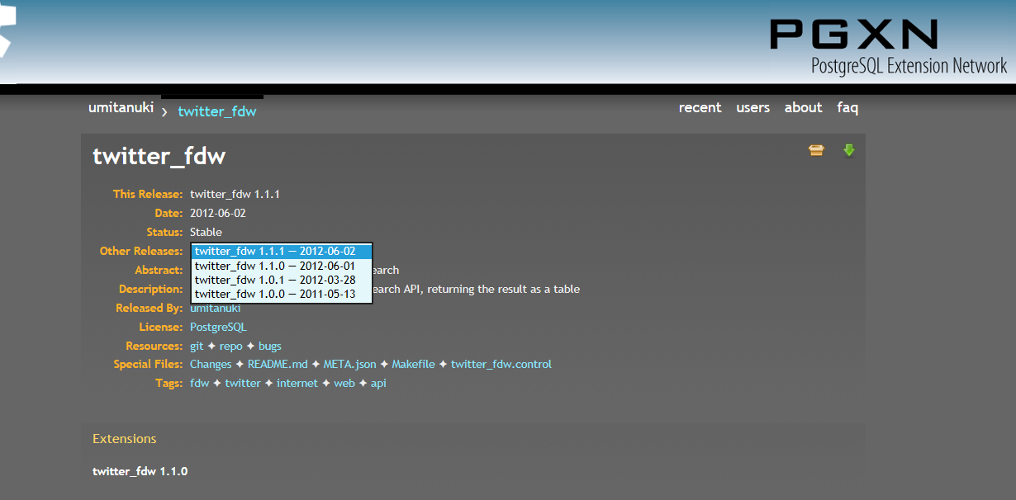
Issues with the Twitter fdw

Slide 9


Issues with the Twitter fdw
The last stable version dates back to 2012/06/02
We were able to install Twitter_fdw only for the version 9.1 of Postgre SQL
Twitter_fdw does not work with the 9.1 version
Compatibility problems with version 1.1 of the Twitter API

Slide 10
Tweets search
Twitter search API :
1. Requires the registration of a Twitter App
2. Requires the authentication through the Twitter OAuth protocol
3. Provide only results matching with a specific search key
Dataset :
1. Does not need registration and authentication
2. Provide results which belong to different areas of interest

Slide 11
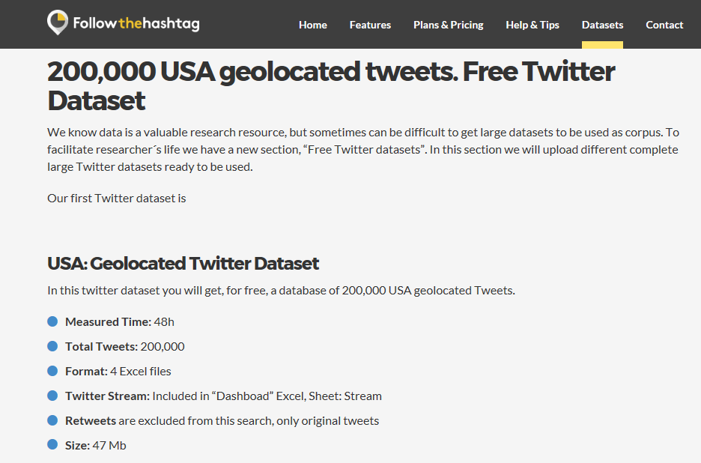
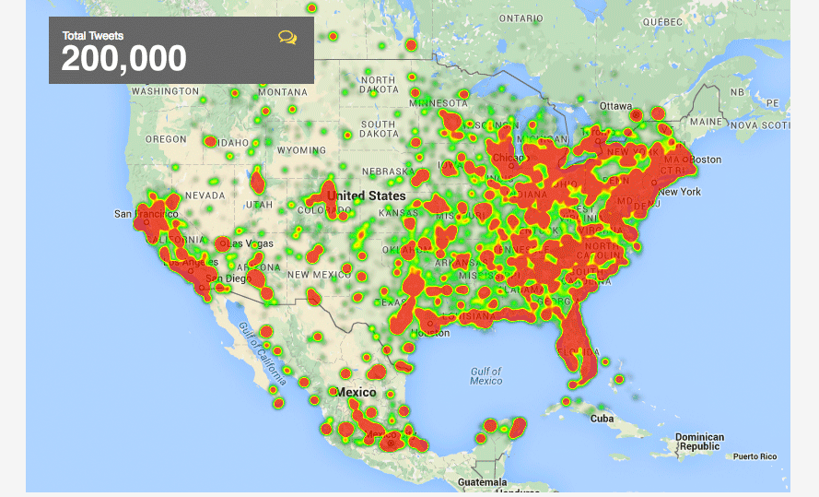
Dataset of 200,000 tweets

Slide 12
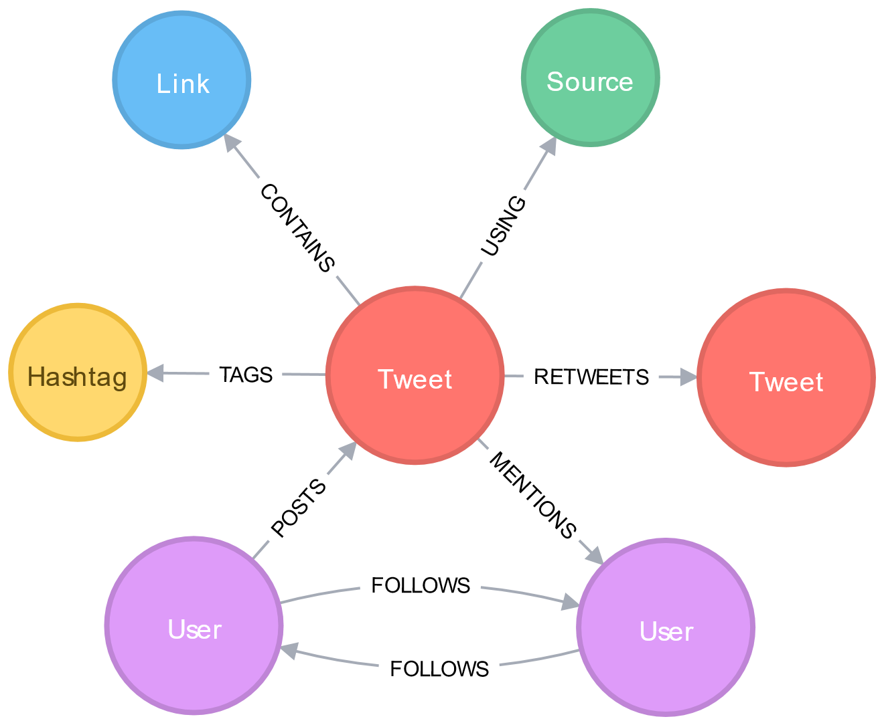
Dataset of 200,000 tweets
Each row of the dataset is made up of 18 elements :
Tweet identifier
Date and hour
Username
Nickname
User biography
Tweet content (Tweet text)
Favs(Favorites)
RTs(Retweets)
Latitude
Longitude
Country
Place
Profile picture
Followers
Following
Listed
Tweet language
Tweet Url

Slide 13
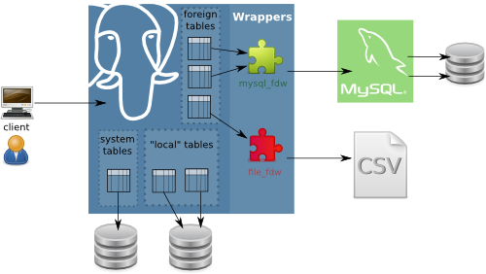
File_fdw
Foreign data wrapper able to :
1) Read data from text, csv or binary files
2) Create a foreign table and copy data
inside it
Options which must or can be set :
1) Filename (mandatory)
2) Format
3) Header
4) Delimiter
5) Quote
6) Escape
7) Null
8) Encoding
Import foreign schema function not supported
Implemented in Postgre SQL starting from 9.2 version

Slide 14
File_fdw
Installation of the file_fdw with the command : make && make install
Creation of the extension :
CREATE EXTENSION file_fdw ;
Creation of the server :
CREATE SERVER server_file_fdw
FOREIGN DATA WRAPPER file_fdw ;
Creation of the user mapping :
CREATE USER MAPPING FOR
SERVER server_file_fdw ;

Slide 15
File_fdw
Creation of the foreign table :
CREATE FOREIGN TABLE tweets_foreign(
tweet_ID varchar(150) ,
datetweet varchar(50),
hour varchar(50),
username varchar(50) ,
nickname varchar(50),
biography varchar(250),
tweet_content varchar(300) ,
favs varchar(150),
rts varchar(50),
latitude varchar(200) ,
longitude varchar(200) ,
country varchar(200) ,
place varchar(200),
profile_picture varchar(200),
followers integer,
following integer,
listed integer,
language varchar(10),
url varchar(200)
) SERVER server_file_fdw
OPTIONS (format 'csv', header 'true' , filename '/tmp/lista_tweets_USA.csv' , delimiter ',' , null '' );

Slide 16
File_fdw
Creation of the local table :
CREATE TABLE tweets_local
AS SELECT * FROM tweets_foreign ;
Removal of the rows in the table with the attributes following, followers
or listed equal to NULL :
DELETE
FROM tweets_local AS T
WHERE T.followers IS NULL OR T.following IS NULL OR T.listed IS NULL ;
Loss of 10k rows from the local table

Slide 17

Why have we converted the csv file into a table before doing the clustering?
Couldn’t we take data directly from the csv file?

Slide 18

Three main reasons :
Skimming data in order to avoid rows with null attributes
Collect information about the dataset through targeted queries
Project requirement

Slide 19
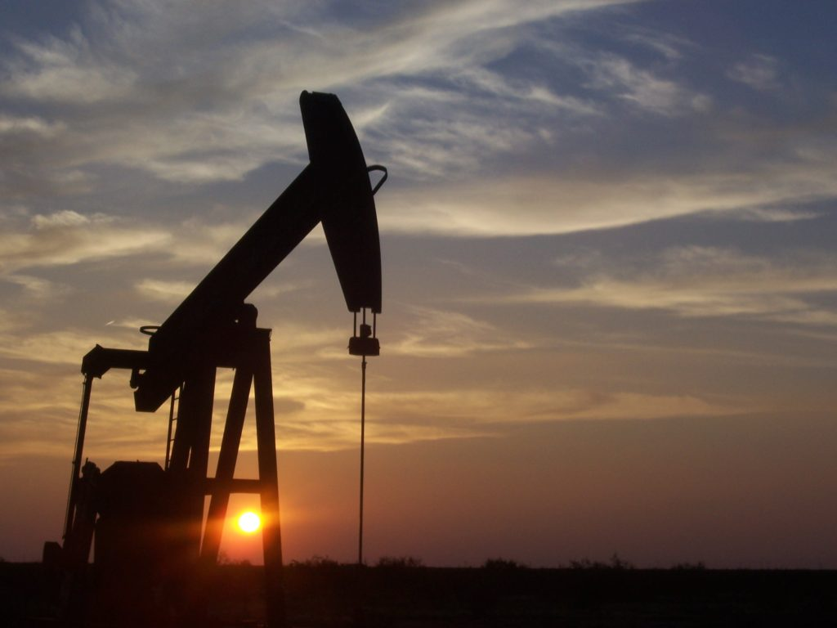
oil
Data
is the new
We need to find it,
Extract it, refine it,
Distribute it and monetize it.
David Buckingham

Slide 20
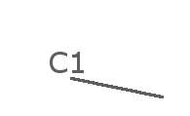



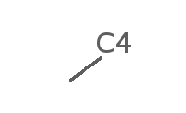



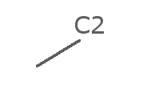
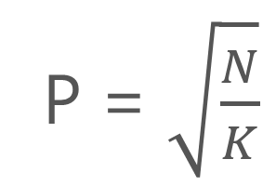
Delving Into Details
Objective
Clustering tweets contents on common themes
Preprocessing on the tweets
Word2Vec →
Lower case
Removing non sense words
Removing all symbols
Parametres
N = 200000
P = $\sqrt{\frac{N}{K}}$
K’ = 2K
K=150
Dim=100

Slide 21




Spark environment
K-Center Clustering with Spark:
P
Divide points P randomly in buckets
Determine 2K centers in each bucket
Group all centers in set C
Determine K centers in set C
Assign points to clusters
….
S1
S2
Si
Round 1

Slide 22
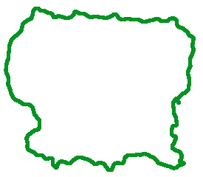
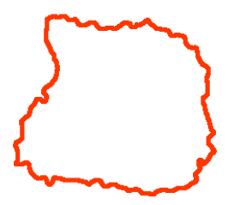

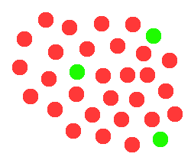
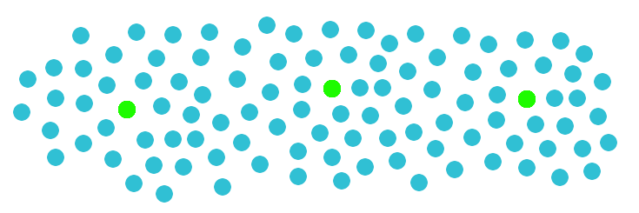
Spark environment
P
C
C
P
Round 2
Round 3

Slide 23

The secret of change is to focus all of your energy, not on fighting the old, but on building the new
Socrates

Slide 24
RESULTS
What our clustering Doesn’t do:
Group tweets based on the number of followers:
Followers average is not representative

Slide 25
RESULTS
What our clustering DOES:
It groups tweets based on their contents – tweets in the same cluster contain similar topics
How to assess it?
Assign tags to tweets
Search for the most frequent tags
Calculate cluster entropy
Calculate frequent tags entropy

Slide 26

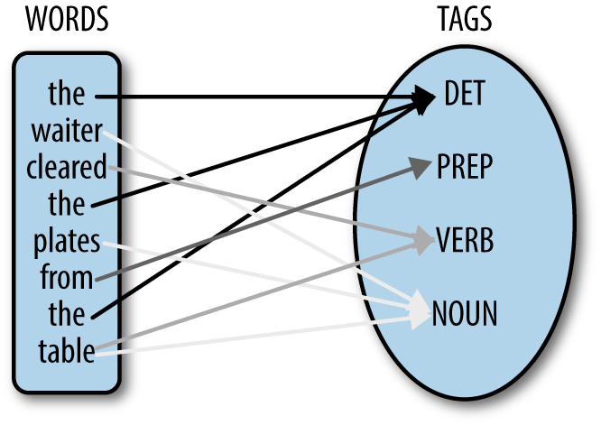
RESULTS
Assign Tags to Tweets
Part-Of-Speech Tagger (POS Tagger)
Stanford Log-linear Part-Of-Speech Tagger
How does it work?
It reads text in some language
It assigns parts of speech to each word
For each cluster only the most frequent nouns are kept – threshold 25%

Slide 27

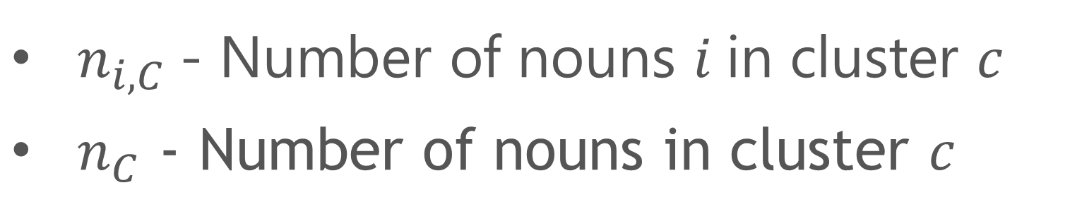
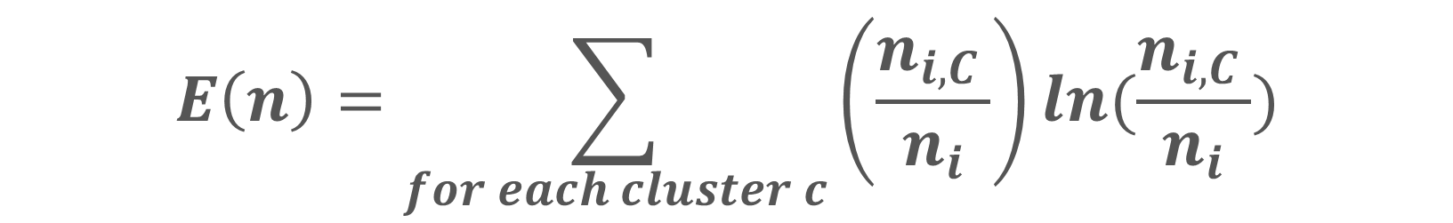
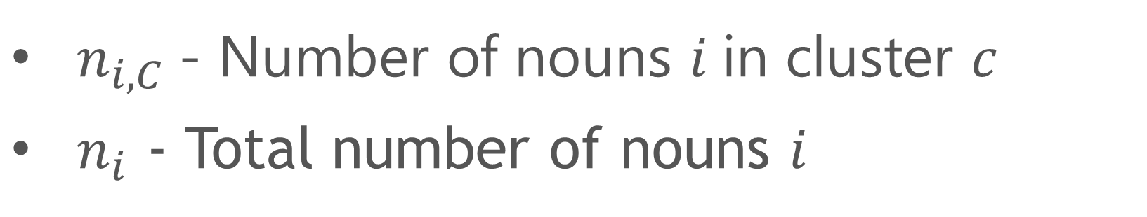
RESULTS
Entropy of a Cluster
Entropy of a Noun
$$E\left(C\right)=\sum_{for each noun i}{\left(\frac{n_{i,C }}{n_{C}}\right)ln(\frac{n_{i,C }}{n_{C}})}$$
$$E\left(n\right)=\sum_{for each cluster c}{\left(\frac{n_{i,C }}{n_{i}}\right)ln(\frac{n_{i,C }}{n_{i}})}$$
Where:
Where:
$n_{i,C}$- Number of nouns $i$in cluster $c$
$n_{C}$ - Number of nouns in cluster $c$
$n_{i,C}$- Number of nouns $i$in cluster $c$
$n_{i}$ - Total number of nouns $i$
Why?
Why?
To see how representative of a noun a cluster is
To see if the noun is distributed in different clusters

Slide 28
RESULTS
Let’s take a look - 1
Cluster: 67
Size: 5192 tweets
Most frequent Noun: I’m
Frequency: 97.5%
Cluster entropy: 0.76
Noun entropy: 1.60
SAMPLE TWEETS
I'm at Rivercenter Mall in San Antonio, TX
I'm at Southwest Plaza Mall in Littleton, CO
I'm at @BangSalonDc in Washington, DC
I'm at @UnderArmour Brand House in Baltimore, MD I'm at park place diner in Lansdale, PA
I'm at @PetSmart in Southfield, MI
I'm at 6PACK in Queens, NY
Applications:
Targeted advertisements
Labeling of users with their interests
Store places that users visit

Slide 29
RESULTS
Let’s take a look - 2
SAMPLE TWEETS
Want to work at CVS Health? We're #hiring in #Denton, TX! Click for details: https://t.co/65C1Pz8R3C #Retail #Job #Jobs #CareerArc
#IT #Job alert: Senior Infrastructure Provisioning Coordinator | Genuine Parts NAPA | #Atlanta, GA https://t.co/FbwrHkOxwA #Jobs #Hiring
Want to work in #McLean, VA? View our latest opening: https://t.co/v5DDZ5PSqR #Healthcare #Job #Jobs #Hiring #CareerArc
Cluster: 147
Size: 31228 tweets
Most frequent Noun: #Jobs
Frequency: 71.68%
Cluster entropy: 1.01
Noun entropy: 0.27
Other frequent Nouns: #Job, #CareerArc
Applications:
Find people who are looking for a job or offering one
Make a list of available jobs

Slide 30
RESULTS
Let’s take a look - 3
Cluster: 83
Size: 3629 tweets
Most frequent Noun: photo
Frequency: 49%
Cluster entropy: 0.66
Noun entropy: 0.57
Links: most point to Instagram
SAMPLE TWEETS
Just posted a photo @ Randolph-Macon College https://t.co/QL5iXtXhfx
On the lake Tahoe in Sierra Nevada with a paddleboard. Photo by @standup_paddle #lake… https://t.co/e8iC0UhyIF
Just posted a photo @ Grand Canyon Skywalk https://t.co/qgruAKCPVY
Just posted a photo @ San Antonio, Texas https://t.co/9SH5PCoUFH
Applications:
Labeling of users with their interests
Store places that users visit
Get information about their Instagram account

Slide 31
RESULTS
How to improve it?
Improve tweets pre-processing:
Transform similar nouns into a single noun (#job,#jobs,#Job -> #job)
Substitute word abbreviations with their extended form (w/ -> with)
Evaluation:
Merge together similar clusters
Repeat the entire process on clusters that don’t contain a frequent word

Slide 32



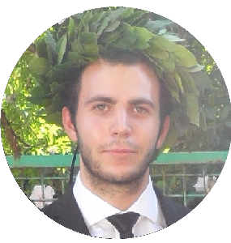
Thanks for your attention
Get in touch with us:
Tommaso Agnolazza
Tommaso.agnolazza@studenti.unipd.it
Alessandro Ciresola
Alessandro.ciresola@studenti.unipd.it
Davide Lucchi
Davide.lucchi@studenti.unipd.it

